Slide 1
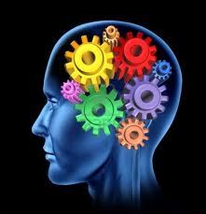




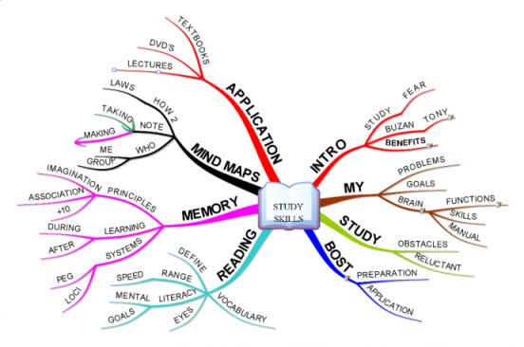
Efficient Study Techniques
Speed Reading, Memory Techniques, Mind Mapping, Efficient Studying, The "BOST" System
Teamwork and
Personal Skills
SoftUni Team
Technical Trainers
Software University
http://softuni.bg

Slide 2



Table of Contents
Efficient Studying Overview
Focus and Concentration
Speed Reading Techniques
Speed Reading: A Typical Process
Speed Reading: Live Exercise
Memory Techniques
Tony Buzan's BOST System
The Photo Reading System
Speed Video Watching
Resources

Slide 3

Efficient Studying
Overview

Slide 4
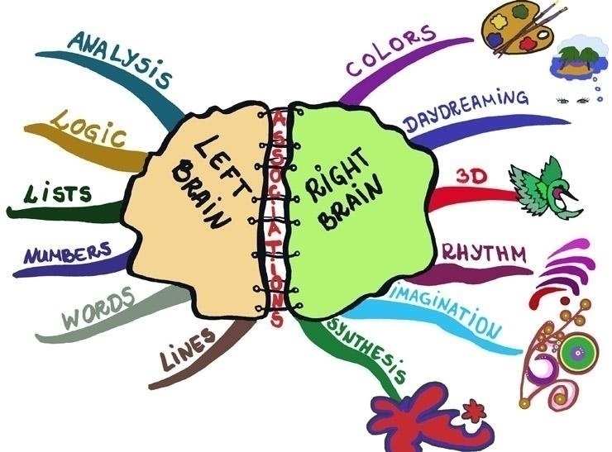
Human Brain: Two Hemispheres
Source: http://www.grammarmindmaps.com/about-mind-maps

Slide 5
Left and Right Brain Combined
The true power of the brain comes when
The left and the right hemispheres are combined to work together
How to combine the left and right brain?
Use logic and imagination together
Use mind mapping
How to study efficiently?
Combine high concentration with speed reading, mind mapping and memory techniques

Slide 6

Focus and Concentration
How to Concentrate for Efficient Studying?

Slide 7

Resourceful State for Learning
Entering a highly-productive state
Known as "flow" (see Mihály Csíkszentmihályi)
Known as "relaxed alertness" (Paul Scheele)
High-concentration tips
Quiet place
Background music
Seat and posture
Breathing techniques
Breaks

Slide 8


Focus and Concentration
Quiet place, without disturbing factors
No people around to distract your attention
Separate room without anyone else
Background music
Classic and baroque improves concentration
Any music for relaxation / meditation will work
Brainwave entrainment / alpha / gamma (link)
Avoid rap / metal / rock / folk (music with lyrics)
Better without headphones

Slide 9


Focus and Concentration (2)
Seat and posture
Comfortable seat
Prefer sitting in a chair (with a back)
Straight up, with a desk, not lop-sided
Lean back against the back of the chair
Distance from eyes
Sufficient lighting
Avoid laying in a bed
Take breaks

Slide 10



Focus and Concentration (3)
Breathing techniques
Help entering a productive state
Improve relaxation
Breaks
Take breaks regularly!
At every 20-50 minutes
5 minutes
Physical activity
Relax, move, stretch

Slide 11

Speed Reading Techniques
Improve You Reading and Comprehension Speed

Slide 12

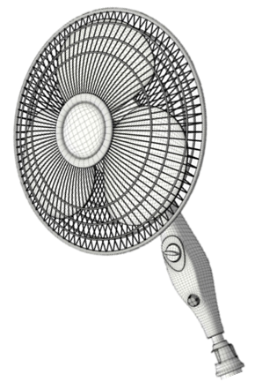


What is Speed Reading?
Speed reading
Non-linear reading
Improves the efficiency
Less time + better recall
Slow readers: 200-250 words / minute
Fast readers: 500, even 1000+ words / minute
Uses techniques like
Preview
Skimming

Slide 13

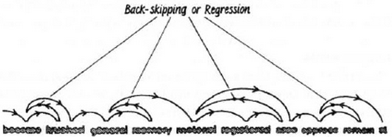

Obstacles to Speed Reading
Subvocalization
Internal speech (pronunciation) during the reading
Back-skipping / regression
Repeated reading of the same text
Eye focusing
Focus on single words / letters
Instead on groups of words / phrases / sentences
See http://www.spritzinc.com

Slide 14


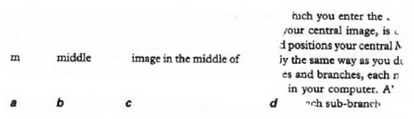
Speed Reading Techniques
Using a pointer
Using a finger or pointer (e.g. pen)
Increase the vision span (field of view)
Focus on groups of words simultaneously

Slide 15

Speed Reading Techniques (2)
Preview the text
Start with this to catch the "big picture"
Quickly pass through the text:
Table of contents, titles, subtitles, figures, captions, tables, bold phrases, etc.
Time-boxed
E.g. 3-5 minutes (for 200 pages)
Don't read, just preview the information!
Extract keywords / important phrases

Slide 16


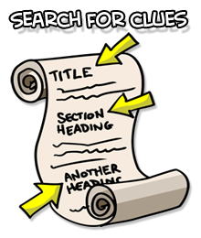

Speed Reading Techniques (3)
Skimming
Quickly pass / scan through the text
Try to extract the meaningful info
Try to find what you need
Often used when searching in Internet
Setting goals
Improves the reading efficiency
Keeps reading focused

Slide 17

Speed Reading
State
Goals
Mind Map
Skim
Preview
A Typical Process

Slide 18

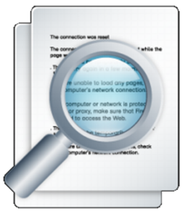
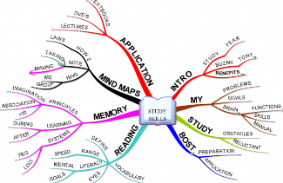
Speed Reading: Typical Process
Enter a state of concentration
Comfort, seat, posture, background music, etc.
Set-up goals for reading
Write a few questions + extract keywords
Quickly preview the text
Time boxed: 3-5 minutes for ~ 200 pages
Skim through the text
Try to find the answers for your questions
Create a mind map

Slide 19
Speed Reading
Following the speed reading typical process read the book "Introduction to Programming with C#" or other technical book for ~ 30 minutes.
State
Goals
Mind Map
Skim
Preview
Live Exercise

Slide 20

Memory Techniques
How to Remember the Information?

Slide 21
Memory
How to remember?
Association (with something well known)
Senses: see it, hear it, write it, try it, feel it, …
Principles of memory (by Tony Buzan):
Senses
Exaggeration
Rhythm and movement
Colors
Numbering
Symbols
Order and patterns
Attraction
Laughter
Positive thinking

Slide 22

How to Remember a Book?
Speed read the book
Create a mind map (very important!)
Review the mind map regularly
After 10 minutes (10 minutes review)
After 24 hours (2-4 minutes review)
After 1 week (2 minutes review)
After 1 month (2 minutes review)
After 6 months (2 minutes review)
After 1 year (2 minutes review)

Slide 23
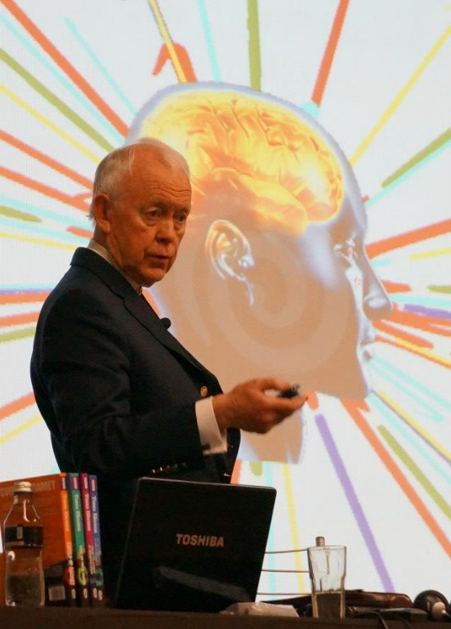

Tony Buzan's BOST System
Buzan's Organic Study Technique

Slide 24
Buzan's B.O.S.T. System
Preparation
Flip all the pages (very quickly)
What you already know on this topic? (mind map)
Time and scope (establish a time schedule)
Set-up questions and goals
Application
Overview: covers, table of contents, headings
Preview: preface and conclusion chapters
In-view: fast read, skip complex parts
Review: fill the gaps + create mind map

Slide 25
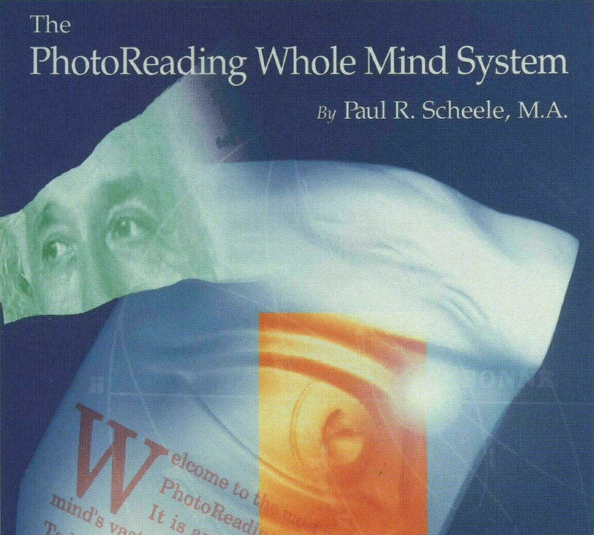
The Photo Reading System
Paul Scheele's Photo Reading Whole Mind System

Slide 26
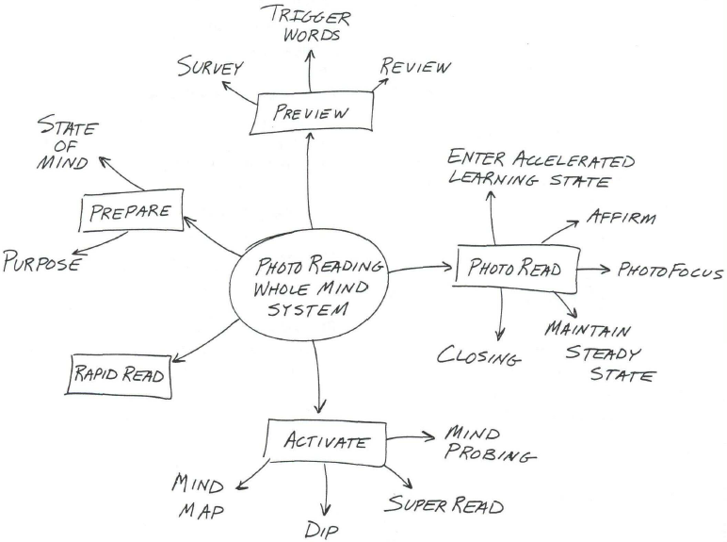
Paul Scheele's Photo Reading System

Slide 27
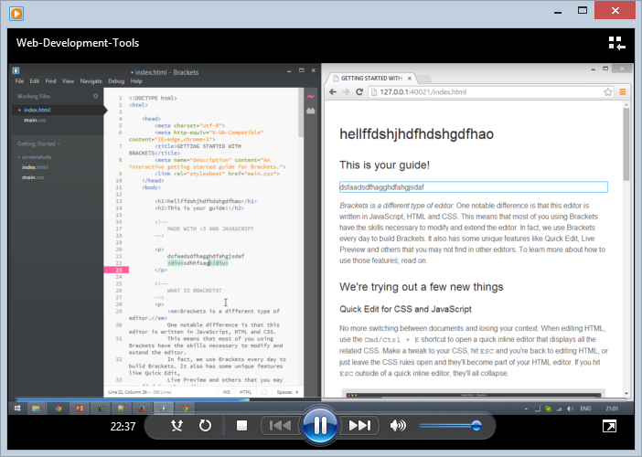
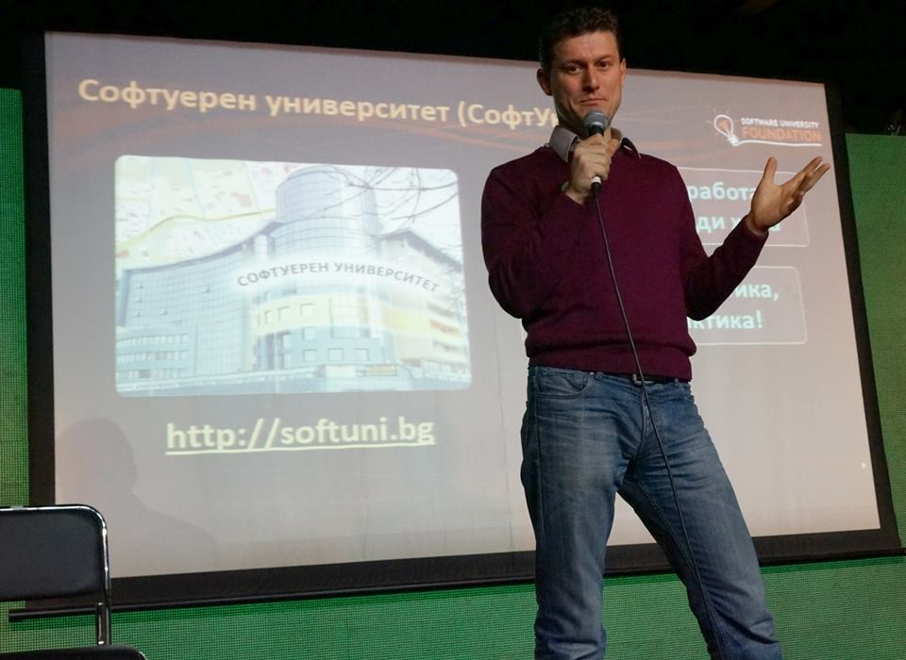

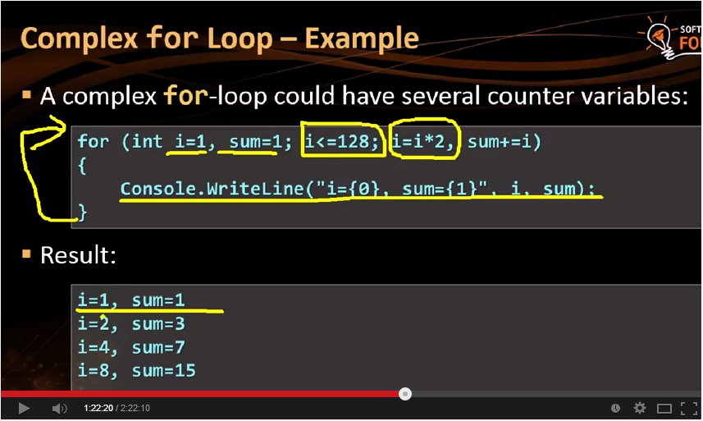
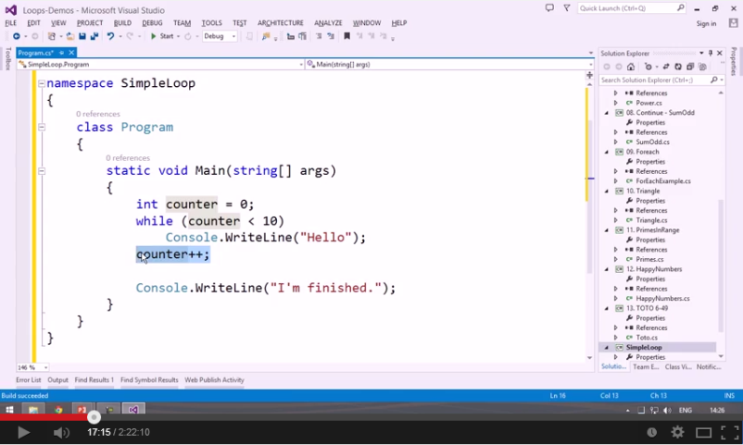
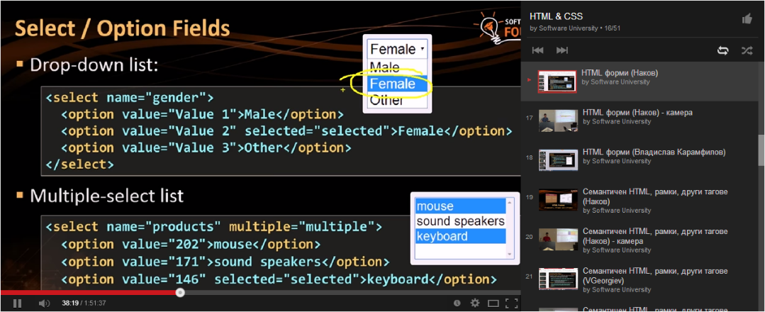

Speed Video Watching
Increase the Speed of Watching Video Lessons

Slide 28

Speed Video Watching Techniques
Perform a quick preview of the video
Scroll through the content for 2-3 minutes
Watch at increased speed
Start with 1.2 x speed
Тhen turn to 1.4 x speed
Тhen turn to 1.6 x speed
Skip uninteresting parts
Skip what you already know or don't find interesting

Slide 29




Resources
Speed Reading and Efficient Study Books

Slide 30




Tony Buzan's Books on Speed Reading and Effective Study
The Buzan Study Skills Handbook (by Tony Buzan)
Как да уча бързо и да запомням лесно? (Тони Бюзан)
The Speed Reading Book (by Tony Buzan)
Как да чета бързо и да постигам повече? (Тони Бюзан)

Slide 31



The Mind Map Books
The Mind Map Book: How to Use Radiant Thinking to Maximize Your Brain's Untapped Potential
by Tony Buzan and Barry Buzan Dutton Adult, 1994 ISBN 9780525939047
Твоят ум може всичко
Тони Бюзан и Бари Бюзан
Софтпрес, 2010 ISBN 978-954-685-814-6

Slide 32
Resources on Effective Study
Ivo Botusharov's Blog on "Effective Study"
Summary of Tony Buzan's effective study books
http://ibotusharov.com/2013/05/17/telerik-academy/knowledge-sharing/effective-study-skills-buzan/
Meta Reading Club and Courses
Combine Lozanov's Suggestopedia / Reservopedia + PhotoReading + Tony Buzan's B.O.S.T System + other innovations
http://www.metareading.com/course/

Slide 33










Efficient Study Techniques
https://softuni.bg/courses/teamwork-and-personal-skills/

Slide 34
License
This course (slides, examples, demos, videos, homework, etc.) is licensed under the "Creative Commons Attribution-NonCommercial-ShareAlike 4.0 International" license
Attribution: this work may contain portions from
"Knowledge Sharing and Team Working" course by Telerik Academy under CC-BY-NC-SA license

Slide 35






Free Trainings @ Software University
Software University Foundation – softuni.org
Software University – High-Quality Education, Profession and Job for Software Developers
softuni.bg
Software University @ Facebook
facebook.com/SoftwareUniversity
Software University @ YouTube
youtube.com/SoftwareUniversity
Software University Forums – forum.softuni.bg

